Slide 1
Employee attrition prediction model
.
Contributed By – Ketan Anand

Slide 2


OUTLINE
MOTIVATION
INTRODUCTION
DATA SET
RESEARCH METHODOLOGY
RESULT
LIMITATION
CONCLUSION

Slide 3
Motivation
As a team of aspiring professionals, we've embarked on a mission to tackle the pervasive issue of employee attrition, a pressing concern in countless workplaces worldwide. With millions of individuals affected by the constant churn of talent, organizations are grappling with the profound impacts of losing valuable team members. Despite extensive research and various retention strategies, the problem persists, leaving companies in a perpetual struggle to maintain productivity and cohesion.
Loss of employees via attrition has severe impacts on the yield of an organization. Finding eligible candidates to replace the ones that have left is a daunting task. This not only leads to higher costs but also induces a relatively inexperienced workforce in the organization. Continuous employee loss also disrupts the work chain and leads to delayed deadlines and lower customer satisfaction. Higher employee attrition diminishes the brand value of an organization

Slide 4
Introduction of project
In this project, we are going to use machine learning algorithms to predict the employee attrition of employee in the organisation. With the help of this project, we will be getting managerial insights to prevent the attrition and helps us to know the factors that lead to a attrition of a employee.

Slide 5
Problem statement
Difficulties Faced: Employee attrition, or the voluntary or involuntary permanent departure of employees from an organization, is a significant challenge faced by many companies. High employee turnover can lead to increased recruitment and training costs, loss of valuable institutional knowledge, and disruptions in organizational productivity.
Symptom Heterogeneity: The diverse factors contributing to employee attrition, such as job satisfaction, work-life balance, career growth opportunities, and organizational culture, make it challenging to identify the root causes and develop effective retention strategies.
Project Goal: Using machine learning techniques, develop a predictive model that can accurately forecast employee attrition risk based on various employee and organizational characteristics. This will enable the organization to implement targeted interventions to improve employee engagement and reduce turnover.
Impact Potential: If the machine learning model is successfully deployed, the organization can enhance its ability to retain talented employees, optimize its workforce, and improve overall business performance and competitiveness.

Slide 6


Feasibility
Hardware: The code does not appear to have any special hardware requirements. It should run on any modern computer having processor similar to i3/i5/i7 or above which is capable of running Python and the necessary libraries. Preferred size of RAM is 8.00 GB or above.
Software: The code uses standard Python libraries for data analysis and machine learning, which are widely supported and easy to install. Therefore, it is feasible in terms of software requirements.

Slide 7
Dataset
Name of the Dataset – WA_Fn-UseC_-HR-Employee-Attrition.csv
Source – https://www.kaggle.com/datasets/pavansubhasht/ibm-hr-analytics-attrition-dataset
For Unprocessed Data –
Number of features – 35
Number of Instances - 1470

Slide 8
Target Variable - Attrition - Discrete datatype
Dataset characteristics –
Age (Absolute) – Feature Contains age of the employee and feature contains continuous datatype.
Business Travel (Nominal) – This feature contains frequency of the travelling done by employee for the business purposes. Feature contains different categories like Travel_Rarely, Travel_Frequently and Non-Travel.
Daily Rate ( ) -
Department (Nominal) – Feature tells about which employee works in which department. Feature has different classes that are Sales, Research & Development and Human Resources.
DistanceFromHome(Interval) – feature tells about the distance of office from the home of employee in kilo-meters , Feature contains continuous datatype.

Slide 9
Education (Ordinal) – feature tells about the education of employee. Feature education contains Below College, College, Bachelor, Master, Doctor where rankings are assigned as 1-Below College,2-College,3-Bachelor,4-Master,5-Doctor
EducationField(Nominal) – Feature tells about the field of education of employee, feature has different classes such as Life Sciences, Other, Medical, Marketing, Technical Degree, Human Resources.
EmployeeCount ( ) –
EmployeeNumber ( ) –
EnvironmentSatisfaction (Ordinal) – features tells about the satisfaction of employee from the environment. It has different classes as low, medium, high, very high where rankings are assigned as 1-Low, 2-Medium, 3-High, 4- very high .
Gender (Nominal) – Contains gender of the employee
HourlyRate ( ) –
JobInvolvement (Ordinal) – feature tells about the involvement of the employee for his role. Feature has different classes as low, Medium, high, very high having rankings as 1- Low, 2-Medium, 3-high, 4-Very High

Slide 10
JobLevel (ratio) – This feature tells about the job level of the employee in the organisation
JobRole(Nominal) -contains data about post of the employee
JobSatisfaction (Ordinal) – feature tells satisfaction pf employee from his job,feature has classes as Low, Medium, High, Very High and have ranking as 1-Low, 2-Medium , 3-High, 4-Very High.
maritalStatus (Nominal) - contains marital status of employee
MonthlyIncome (Interval) - tells data about income of employee per month
MonthlyRate ( ) –
NumCompaniesWorked (Interval) – This feature tells about the number of companies
in which employee worked from starting of his career

Slide 11
Over18 (Nominal) – tell either the employee 18+ or not
OverTime (Nominal) – tells which employees works over time
PercentSalaryHike ( ) –
PerformanceRating (Ordinal) – This feature tells performance of employee having classes Low, Medium, High, Very High and rankings are assigned as 1-Low, 2-Medium,3- High, 4-Very High
RelationshipSatisfaction (Ordinal) – This feature tells satisfaction of his relationships of employees. Feature has different classes as low, Medium, high, very high having rankings as 1- Low, 2-Medium, 3-high, 4-Very High
StandardHours ( ) –
StockOptionLevel ( ) –
TotalWorkingYears (Interval) - tells total working year of employee
TrainingTimesLastYear (Interval) – tells training frequency of employee on previous year

Slide 12
workLifeBalance (Ordinal) – feature tells work life balance of employee, feature has different classes that are Bad, Good, Better, Best and rankings are assigned as 1-Bad, 2-Good, 3-Better, 4-Best.
YearsAtCompany (Interval) – tells working years of employee in company
YearsWithCurrentRole (Interval) – tells years of working of employee at his jobrole
YearsSinceLastPromotion (Interval) – tells years from which employee has not awarded the promotion
yearsWithCurrManager (Interval) - tells year of working with the current manager of employee
Attrition (Nominal) – tells whether the employee takes retirement or not

Slide 13
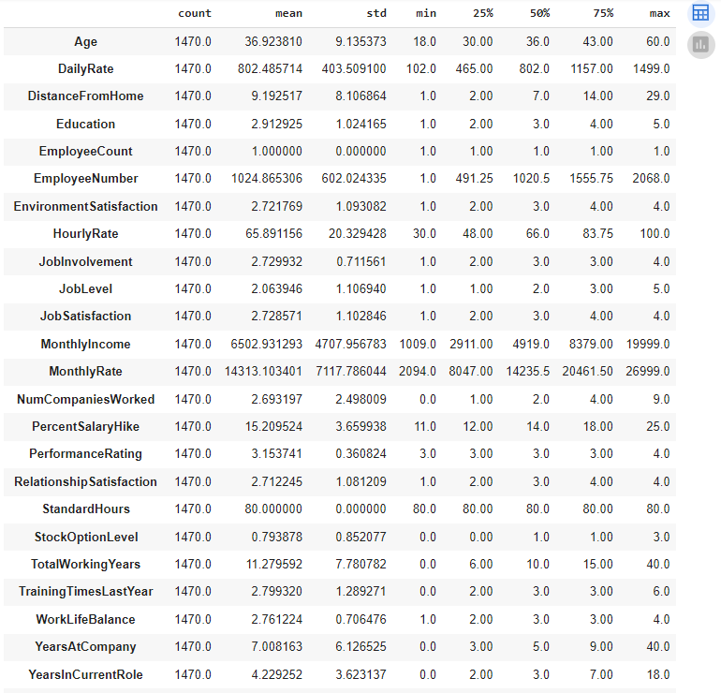
.
.

Slide 14
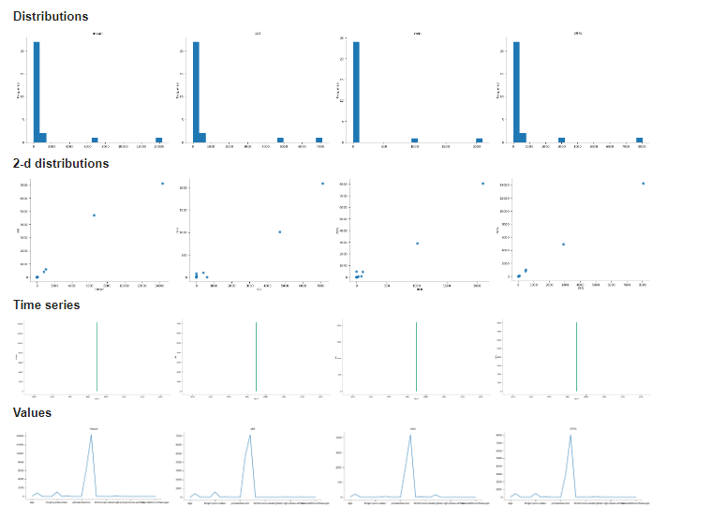
.
.

Slide 15
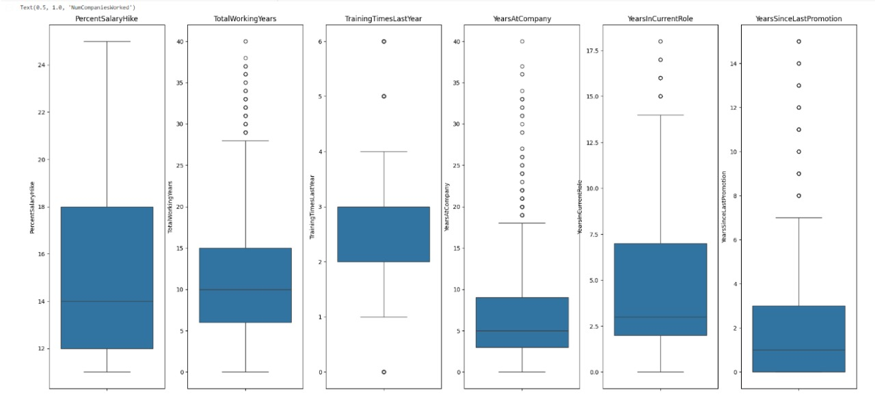
BOXPLOT

Slide 16
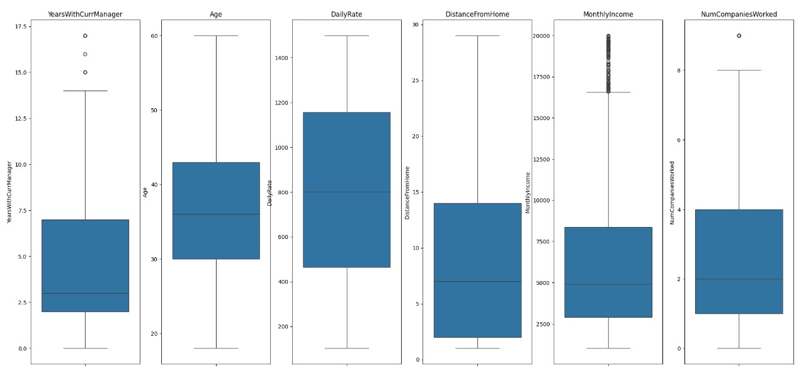

Slide 17
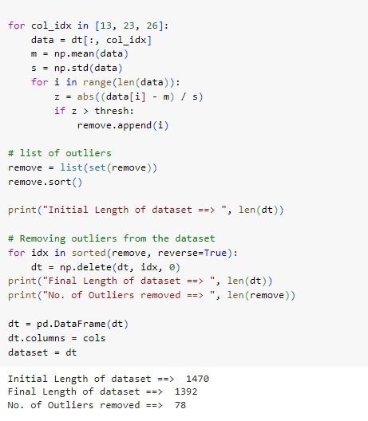
Implementing Z- Score to Remove Outliers

Slide 18
Research Methodologies :-
Feature Selection
Deleting noisy features
Creating new attributes
PREPROCESSING
Dummy variables
Removal of outliers
Feature Scaling
Handling imbalanced data
DATA COLLECTION
Kaggle – HR employee attrition
Models Developed
Decision Tree Classifier
Logistic Regression
Perceptron Learning
Gradient Boosting
Naive Bayes
Result (Performance Measures)
Accuracy
Precision
Recall
F1 - Score

Slide 19
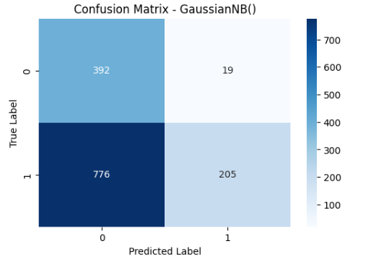
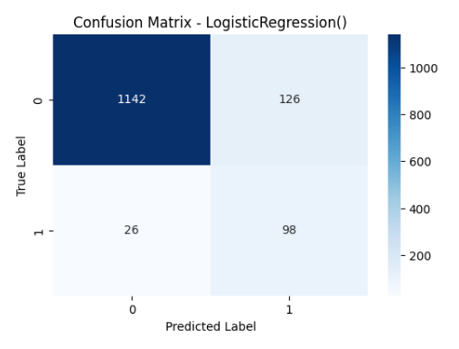
Confusion Matrix

Slide 20
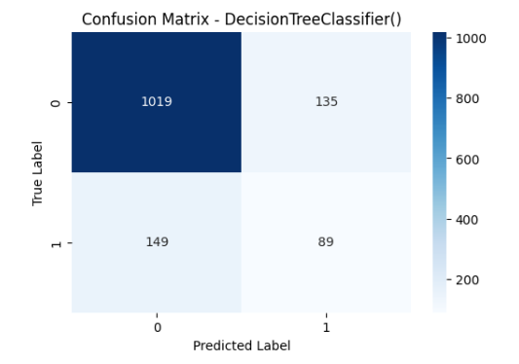
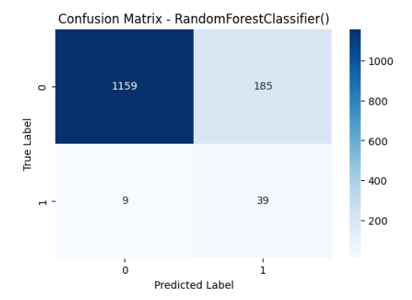

Slide 21
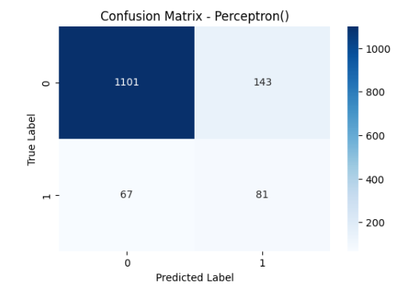
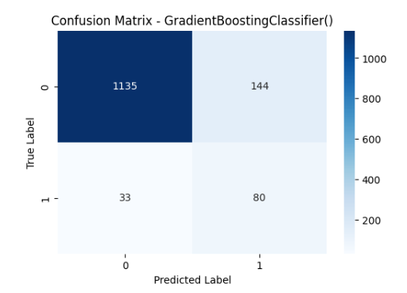

Slide 22
Models Used | Accuracy | Precision | Recall | F1 – Score
Gaussian Naïve Bayes | 42.89 | 20.9 | 91.48 | 33.94
Logistic Regression | 89.08 | 79.85 | 44.19 | 55.93
Decision Tree Classifier | 76.67 | 36.97 | 39.48 | 37.95
Perceptron | 84.91 | 57.34 | 35.67 | 40.05
Gradient Boosting | 87.36 | 73.72 | 35.89 | 47.37
Random Forest | 86.5 | 84.29 | 19.54 | 31.14

Slide 23
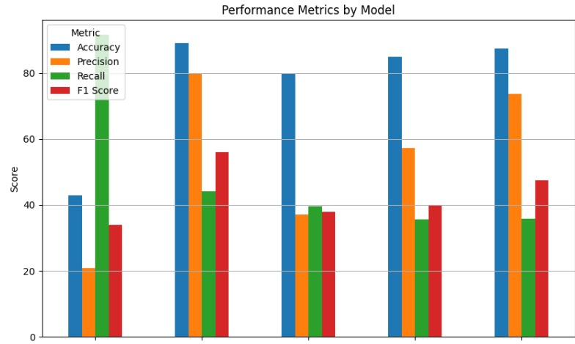
Gaussian Naïve Bayes
Logistic
Regression
Decision Tree
Classifier
Perceptron
Learning
Gradient Boosting

Slide 24
Which Model is Best And Why?
In our project , we find the Logistic Regression Model, the best algo for our dataset.
Accuracy is maximum of Logistic Regression Model .
However, logistic regression remains a popular choice for its simplicity, interpretability, speed, and efficiency in many binary classification tasks, including employee attrition prediction.

Slide 25
Conclusion
As seen from accuracy values of baseline condition we can conclude that accuracy indeed is not a good metric in case of imbalanced data.
Up-sampling the minority class by generating synthetic samples lead to better detection of the minority class but the degree of trust in that detection falls down.
The higher precision and lower recall values in baseline condition concludes that the minority class is not detected much but whenever detected the degree of trust is high.
Finally, it can be concluded that Random Forest, Gradient Boosting, Logistic Regression are the best models among the above mentioned.
The important features extracted after application of random forest coincide with the real world which conclude that the model has real world uses despite being trained on a synthetic data-set.

Slide 26
References
Rahul Yedida, Rahul Reddy, Rakshit Vahi, Rahul Jana, Abhilash GV, Deepti Kulkarni. "Employee Attrition Prediction". 02 November 2018.
Mehdi Naseriparsa, Mohammad Mansour Riahi Kashani "Combination of PCA with SMOTE Resampling to Boost the Prediction Rate in Lung Cancer Dataset".
Data Preprocessing in Data Mining – GeeksforGeeks
Machine Learning: What It is, Tutorial, Definition, Types – Javatpoint
Employee Attrition (kaggle.com)

